Slide 1

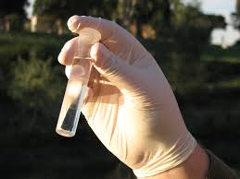
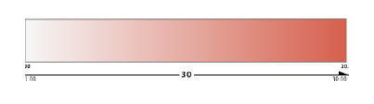
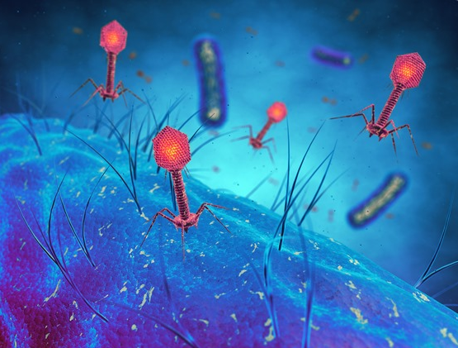
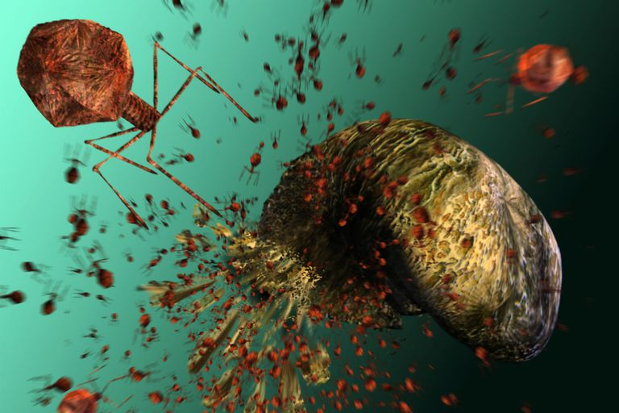
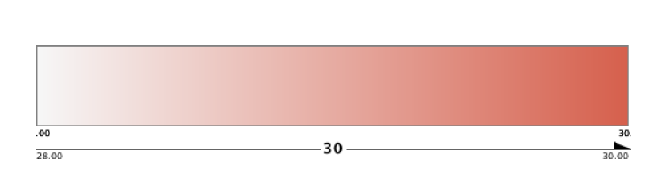
Bacterial and Viral Co-occurrence Across Samples in Lake Michigan to Predict Potential Infection
Tien T. VoNguyen³, Ashley J. Mulford¹, Elyse C. Geoffroy¹, Mark V. Albert³, Catherine Putonti^{2,3}
(1) Bioinformatics Interdisciplinary Program, (2) Department of Biology, (3) Department of Computer Science
Loyola University Chicago
Background
Data Collection
Results
Viruses are unable to reproduce without a host
Bacteriophages, a type of virus, use bacterial cells as their hosts
Cell machinery is hijacked for replication of genetic material
Host cell undergoes lysis and new viruses emerge
Thirty-one water samples collected from Lake Michigan over the course of twelve weeks
Genetic material isolated, sequenced, and inputted into BLAST algorithm for identification
Known species compiled into data tables with corresponding quantity value
Node Edge Weight
Phage
Host
Corresponding Viral Sample |  |  |  |  |  | V2S1 | V1S5 | V2S2 | V2S3
Date |  |  |  |  |  | 140513 | 140513 | 140513 | 140513
Kingdom | Phylum | Class | Order | Family | Genus
Bacteria | Actinobacteria | Actinobacteria | Actinomycetales | unclassified | unclassified | 16423 | 24034 | 13561 | 7675
Bacteria | Bacteroidetes | Flavobacteria | Flavobacteriales | Flavobacteriaceae | Flavobacterium | 26406 | 21836 | 32021 | 12547
Bacteria | Proteobacteria | Betaproteobacteria | Burkholderiales | Comamonadaceae | unclassified | 8169 | 13392 | 13219 | 2306
Bacteria | Bacteroidetes | Sphingobacteria | Sphingobacteriales | Cytophagaceae | unclassified | 8770 | 8606 | 17086 | 3725
Bacteria | unclassified | unclassified | unclassified | unclassified | unclassified | 4523 | 3482 | 1285 | 2615
Bacteriophages invading and infecting a bacterial cell
Bacteriophages breaking out of host cell
Relevance to the Medical Field
Bacterial data showing five species in table from four different lake water samples
Growing antibiotic resistance of bacteria necessitates the development of alternative treatments for infection
Bacteriophages infect bacterial cells that are harmful to humans, and can act as this alternative treatment
Genome networks show the infection relationship between phages and bacteria, which is vital in developing these new treatments
Accession Number | Spp | Number of Proteins in Genome | Number of Hits to Genome | Percent Proteins Hit
NC_011165 | Pseudomonas phage LBL3 | 88 | 248 | 95.45
NC_019503 | Escherichia phage ime09 | 268 | 106 | 10.07
NC_024625 | Peridroma alphabaculovirus | 139 | 32 | 3.6
NC_002321 | Staphylococcus phage PVL | 62 | 20 | 11.29
NC_022987 | Xylella phage Prado | 52 | 24 | 9.62
Genome network at a threshold of 50% viral genome found with a bacterial cell count of 100, showing all correlations across samples that could be indicative of infection relationship
Viral data showing the first five phages in table from a single lake water sample
Abstract
Data Processing
Edge Weight
There is much unknown about the functions of viruses in the field of bioinformatics. Despite being present on all surfaces, only a small fraction of viruses are classified, whereas most bacterial functions are known. To further understand the function of viruses, one must also look at their interactions with certain bacteria. Viruses cannot live on their own, as they require a host cell to reproduce. In the case of bacteriophages, a specific type of virus, the host is a bacterial cell. The best way to increase the understanding of the infection relationship between specific phages and their host cells is through the analysis of co-occurrence across lake water samples. By seeing which bacteria and viruses are present together in multiple samples, the correlation between the two can be found, as viruses will only be able to reproduce through their corresponding bacterial host cells. The goal for this project is to create genome networks from Lake Michigan water samples to illustrate the potential bacterial and viral infection relationships. By placing various thresholds on the data and then running it through code, edge lists were created. These edge lists include the bacteria name, virus name, edge weight, and node weight. From there, the edge lists were imported into Cytoscape, a bioinformatics program that outputs genome networks, showing the co-occurrence in varying degrees between viruses and bacteria. While the networks cannot determine with certainty whether the virus actually infects the bacteria, it provides the visual representation of the correlation that exists across samples, which can be useful to bioinformaticians as they continue their study on viruses.
Begin with raw data, in the form of tables, containing species name and quantity
Python code in Jupyter Notebook reads in the data files and uses packages ‘numpy’ and ‘pandas’ to determine co-occurrence for different thresholds, set by the user
Edge lists containing two nodes for the species and a numerical value for the edge weight are produced
Insert edge lists into Cytoscape to produce the genome networks, depicting the relationships between the viruses and bacteria across samples
Edge Weight | Virus | Bacteria
30 | NC_011165_Pseudomonas phage LBL3 | Bacteria_Actinobacteria_Actinobacteria_Actinomycetales_unclassified_unclassified
30 | NC_011165_Pseudomonas phage LBL3 | Bacteria_Bacteroidetes_Flavobacteria_Flavobacteriales_Flavobacteriaceae_Flavobacterium
30 | NC_011165_Pseudomonas phage LBL3 | Bacteria_Proteobacteria_Betaproteobacteria_Burkholderiales_Comamonadaceae_unclassified
30 | NC_011165_Pseudomonas phage LBL3 | Bacteria_Bacteroidetes_Sphingobacteria_Sphingobacteriales_Cytophagaceae_unclassified
30 | NC_011165_Pseudomonas phage LBL3 | Bacteria_unclassified_unclassified_unclassified_unclassified_unclassified
30 | NC_011165_Pseudomonas phage LBL3 | Bacteria_Bacteroidetes_Sphingobacteria_Sphingobacteriales_Chitinophagaceae_Sediminibacterium
30 | NC_011165_Pseudomonas phage LBL3 | Bacteria_Proteobacteria_Betaproteobacteria_Burkholderiales_Burkholderiaceae_Polynucleobacter
30 | NC_011165_Pseudomonas phage LBL3 | Bacteria_Proteobacteria_Betaproteobacteria_Burkholderiales_unclassified_unclassified
30 | NC_011165_Pseudomonas phage LBL3 | Bacteria_Proteobacteria_unclassified_unclassified_unclassified_unclassified
Genome network at a threshold of 50% viral genome found with a bacterial cell count of 100, filtered to show strongest correlations only, indicating potential infection relationship
Acknowledgments
Edge list with a 50% viral genome threshold and a bacterial cell count of at least 100. List includes quantity of corresponding samples, virus name, and bacterium name
This project was made possible by:
Loyola University Chicago Summer Research Program
Loyola University Chicago F.Y.R.E. Program (2018)
Loyola University Chicago Computer Science and Bioinformatics Departments

